Slide 1
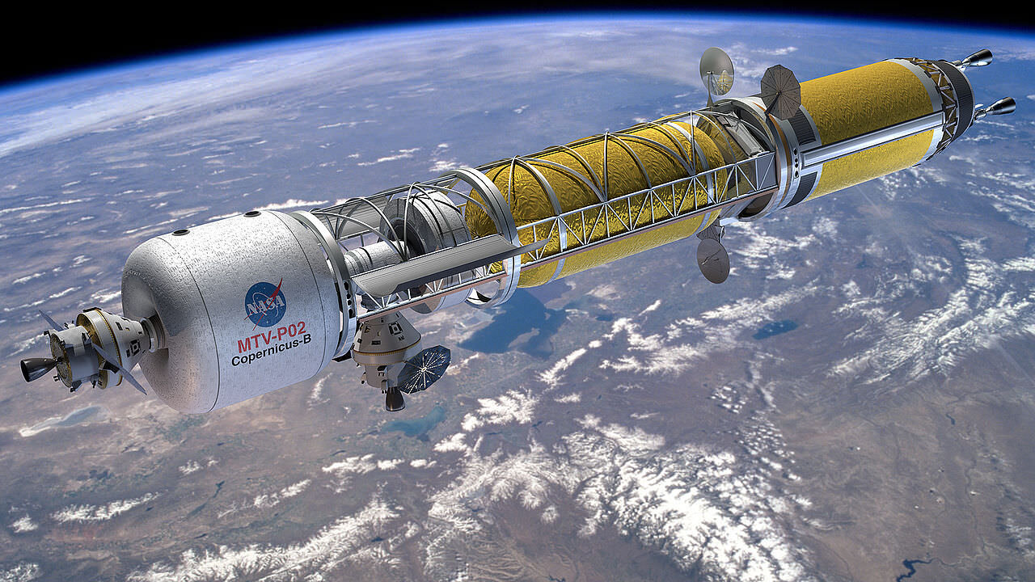
Team 514: Hydrogen Pre-Heater in the Nuclear Thermal Rocket Simulation
Michael Corak
Kevin Hartzog
Jordan Weid
Notes:
Big picture stuff
- We've been given full design constraints
- We will give our designs for final review this Friday
- We will solve interface solution within two weeks
- Cost/benefit analysis of designs

Slide 2
Team Introductions
Michael Corak
Project & Aero-Thermal
Engineer
Kevin Hartzog
Project Manager &
Aero-Thermal analysis
Jordan Weid
Simulation/Structural
Design Engineer
Jordan Weid

Slide 3
Sponsor and Advisor
Engineering Mentor
Michael Schoenfeld
Nuclear Systems Team Lead
Academic Advisor
Rajan Kumar, Ph.D.
Associate Professor
Jordan Weid

Slide 4
Objective
Provide a tool to allow user to choose heating components to achieve desired outlet temperature for pre-heating
Design a heat exchanger that meets fixed operating requirements
Jordan Weid
Notes:
Note that new objective includes fixed operating requirements
Nasa and customers, choose heating components to achieve desired outlet hydrogen temperature of the pre-heater, allows them to more easily reach their main test chamber temps

Slide 5
Key Goals
Give the user and customers of NASA a reference to help in the design of future heat exchangers that operate under different conditions
1
Provide heat exchanger design recommendations that allow customers to choose based on their application
2
Construct a complete heat transfer analysis of each design recommendation
3
Jordan Weid
Notes:
Complete means all aspects of the heat transfer are known and controlled, in this case: working fluid, temp changes, mass flow rate, pressures, and geometry
Different conditions means mass flow rate, power rating, temperature rise
Ground work of different specific applications already completed, such as mixing or temperature rise
1 is research, 2 application/engineering, computation/analysis to validate

Slide 6
Project Background
T4
T3
Temperature (K)
Motivation - simulate the conditions found at any length of test article
T2
T1
Distance (in)
50 inches
Standard Uranium core size
28 inches
NTREES test article size
Jordan Weid
Notes:
Nuclear thermal rocket in past, hard to simulate with uranium and hydrogen, so we used induction coils. Standard ur. Size is 50
Inches vs 28 test article size. We need pre-heater to meet temperatures past the 28 inch mark.

Slide 7
Design Space
Axial direction
28 inches in axial direction
2 inches diameter
Jordan Weid

Slide 8
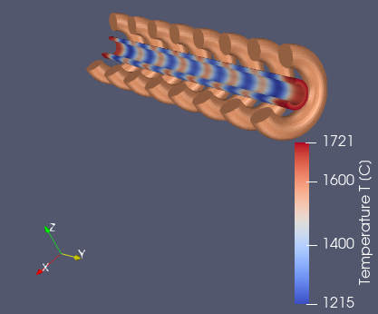
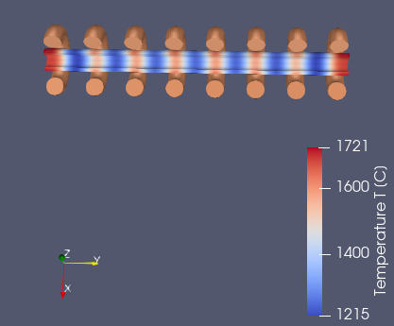
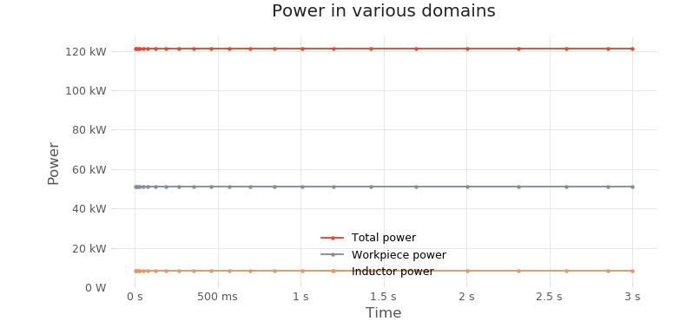
Past Work
Induction coil heating modeled via convenient software called CENOS
Choose frequency and amperage as electrical boundary conditions
Planned workflow was to get the $\dot{q }$(W/m^2) from CENOS analysis inserted as constant heat flux boundary condition in ANSYS
Problem - CENOS does not provide surface heating in the solver but does provide power ratings of the induction coil
Jordan Weid
Notes:
CENOS allows you to make simple induction coil shapes and input electrical boundary conditions like frequency and current
Can use workpiece power / area as flux to input in to ANSYS

Slide 9
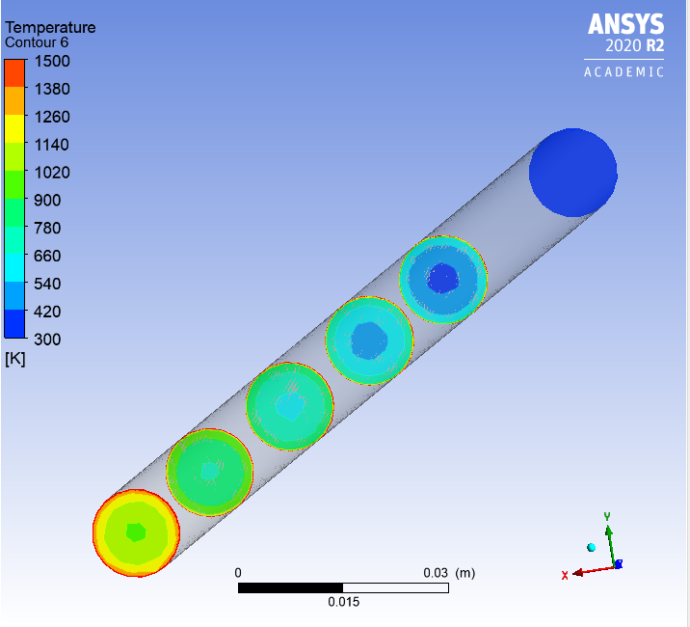
Past Work
Flow Direction
ANSYS independent analysis using standard heat equation as constant heat flux boundary condition
$\dot{Q}=\dot{m}C_{p}dT$
$\dot{q}= \dot{Q}/A_{s}$
Analysis was performed to heat from 300K to 2000K at 0.01 kg/s
$$πDL$$
Temperature Distribution for 10-inch-long cylindrical heat exchanger
Jordan Weid
Notes:
Note that this is an arbitrary analysis, it means nothing
Note the independent part means the flux was found from the Energy equation not from CENOS
Big picture – notice heating on walls increasing, and a clear temp contour

Slide 10
Adjusted Scope
Removed induction coil design and modeling from scope
Removed mounting solution from scope
Focus is to outline and design heat exchanger that meets dynamic targets
Jordan Weid

Slide 11
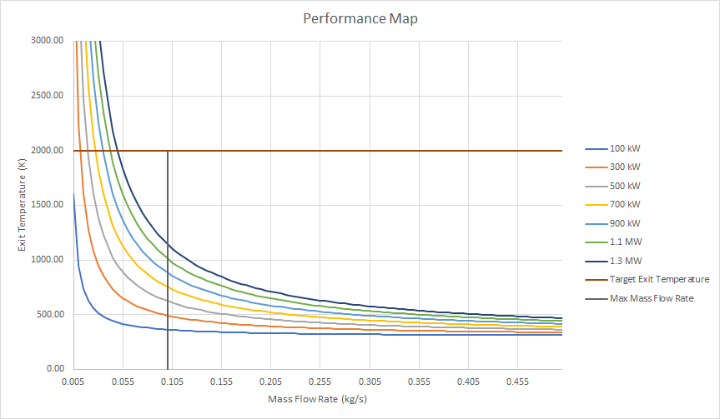
Adjusted Scope Past Work
Provided a tool to select pre-heater power levels and HE(Heat exchanger) geometries for different operating conditions like mass flow rate and temperature rise
Investigated simple cylindrical heat exchanger and conduct heat transfer analysis
Jordan Weid
Notes:
Discuss the two operating lines

Slide 12
Current Work
Presented preliminary HE design recommendations to sponsor
Given set requirements: 100kW, 10g/s, >900 K outlet temp
Given geometrical constraints: 28-inch axial distance, 2-inch diameter
Created several designs with these requirements
Kevin Hartzog

Slide 13
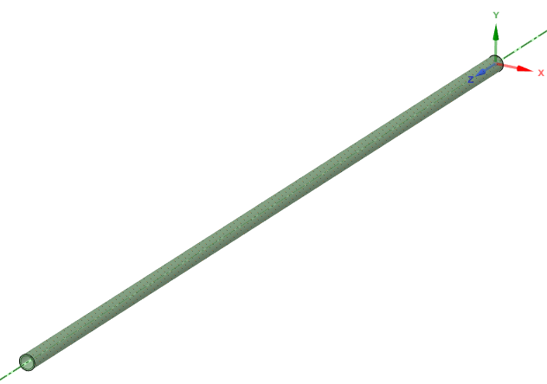
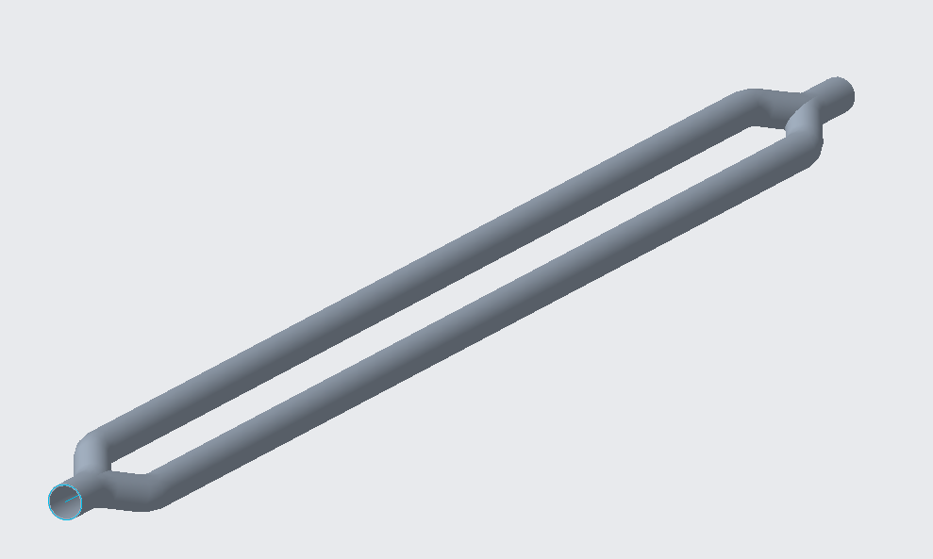
Current Heat Exchanger Designs
Cross section
Baseline with Tombstone Mixer
2 Pass
Simple Pipe With Diffuser
Spiral 4-Pass
Kevin Hartzog
Notes:
Talk about the tombstone making a small wake region where bulk mixing is enhanced
Mixing vs heating were design parameters
Other designs increase surface area to increase exposed area to induction heating

Slide 14
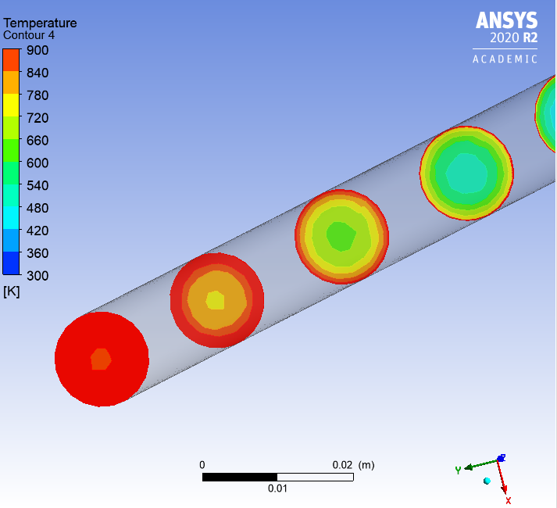
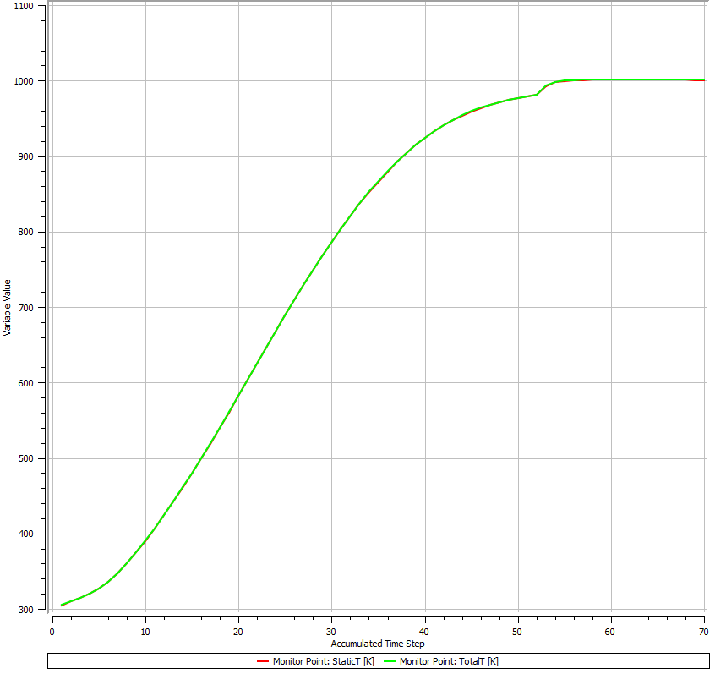
Current Work
CAD
ANSYS
Creo to ANSYS workflow
Validating each design
Evaluating each design
Manufacturability
Material choice
Design Changes
Analysis
Post-Processing
Kevin Hartzog
Notes:
Validate includes mixing, outlet temperature

Slide 15
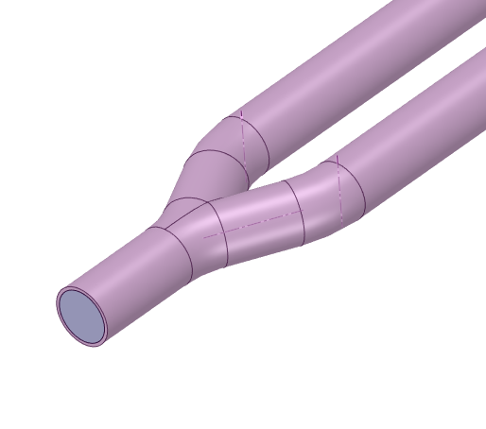
Current Work
CAD geometry created in Creo
Fluid extracted using ANSYS
Kevin Hartzog
Notes:
Validate includes pressure drop, outlet temperature

Slide 16
Current Work
Meshing in ANSYS
Inflation layer added to account for boundary layer effects
Proximity mesh for sharp turns or corners
Kevin Hartzog
Notes:
These are meshing tools in order to more accurately reflect the problem at hand

Slide 17
Current Work
Analysis set up
Boundary conditions
Fluid properties
Kevin Hartzog
Notes:
How detailed is description

Slide 18
Current Work
Baseline design
Simple cylindrical shape
Kevin Hartzog

Slide 19
Current Work
Design 1
Tombstone mixer
Kevin Hartzog

Slide 20
Current Work
Design 2
Diffuser mixer
Kevin Hartzog

Slide 21
Current Work
Design 3
2-pass
Jordan Weid

Slide 22
Current Work
Design 4
Spiral 4-pass
Jordan Weid

Slide 23
Current Work
Design 4
Spiral 4-pass
Jordan Weid

Slide 24
Current Work
Design 5
Interior fins
Jordan Weid

Slide 25
Current Work
Results
Design | Outlet Static Pressure (Pa) - Mass Averaged | Outlet Static Pressure (psi) - Mass Averaged | Outlet Static Temperature (K) - Mass Averaged
Baseline | 6859300 | 994.82 | 1014.5
Design 1 - Tombstone Mixer | 6846900 | 993.02 | 1013.4
Design 2 - Diffuser | 6898500 | 1000.51 | 1066
Design 3 - 2-pass | 6876000 | 997.24 | 1008
Design 4 - Spiral 4-pass | 6890000 | 999.27 | 1001
Jordan Weid

Slide 26
Future Work
Higher fidelity heat transfer analysis
Better predicts induction heating for multi-pass HE
Further iteration to achieve greater outlet temperatures
Solution for interface of outlet to existing test articles
Induction heating only on exposed surfaces
Kevin Hartzog
Notes:
Outline interface to test article

Slide 27
Future Work
Interface of HE outlet to test articles
Manufacturability analysis
Material choice analysis
Kevin Hartzog

Slide 28
Assumptions
FEA
Negligible radiation and convective heat transfer outside of HE
1 dimensional conduction heat transfer
Negligible compressibility effects
Geometry
HE retains ½ inch inlet diameter
Kevin Hartzog
Notes:
Talk about how ½ diameter allows for the easiest integration with existing systems and also so extra time isn't spent designing more components

